Slide 1

Hardware System Design (Week 3) Verilog Design 1
March 25, 2020
Sungjoo Yoo
Computing Memory Architecture Lab.
CSE, SNU
http://cmalab.snu.ac.kr

Slide 2
Agenda
Lecture
Verilog design basics and testbench
Notes:
In the four weeks from now, we study Verilog design.
In the first week, we will cover Verilog basics and testbench.

Slide 3
Software/Hardware Partitioning
MLP is our application
Each layer is matrix-vector multiplication, e.g., 256x1024 matrix * 1024-d vector ➔ 256-d vector
ARM CPU runs the main function which calls your MV IP on PL
MV for 64x64 weight matrix * 64-entry input vector multiplication
BRAM is used for data transfer between SW and HW
Xilinx Zynq (XC7Z020)
One layer in MLP (Software running on CPU)
Processing System
(PS, ARM Co-A9)
Programmable Logic
(PL, Xilinx Artix-7)
for(j=0; j<1024; j+=8) {
for(i=0; i<256; i+=8) {
Output[i] += Input[j]*W[i,j] + Input[j+1]*W[i,j+1] + …
Output[i+1] += Input[j]*W[i+1,j] + Input[j+1]*W[i+1,j+1] + …
…
Output[i+7] += Input[j]*W[i+7,j] + Input[j+1]*W[i+7,j+1] + …
}
}
Core #1
MV function on Hardware
Matrix-Vector Multiplication Custom IP
Core #2
Memory interface
AXI master
BRAM
Notes:
The Verilog design corresponds to the MV accelerator design in our lab and term project.

Slide 4
Hardware (MV Accelerator) Design
Baseline Accelerator
It computes multiple row*vector multiplications in parallel
Each PE is in charge of multiplication of one row * vector
Each PE multiplies input pairs and accumulates the multiplication result with the existing result in the accumulator
X0XX0X0X
Vec
Matrix
PE0
X0XX0XX
0X00X0X
PE1
Notes:
As we studied in the previous week, our MV accelerator consists of PEs (MAC units) and memory components (BRAM).

Slide 5
Block-based Matrix-Vector Multiplication Example
1st clock cycle: Broadcast ‘1’ to two PEs and each PE multiplies the broadcast vector element by its own weight and updates accumulator
Matrix (M)
Vector (V)
a
b
1
a
1
c
1
c
d
5
x
x
+
+
Accumulator
Accumulator
Notes:
We do block-based matrix-vector multiplication.
We already covered this slide in the previous class.
I hope you will review how the block-based MV works using the slides of the previous class.
This slide shows how what happens in the first clock cycle.
Each of PE multiplies two inputs (one broadcast from the vector and the other from the matrix).

Slide 6
Block-based Matrix-Vector Multiplication Example
2nd clock cycle: Broadcast ‘5’ to two PEs and each PE multiplies the broadcast vector element by its own weight and updates accumulator
Matrix (M)
Vector (V)
a
b
1
b
5
d
5
c
d
5
x
x
+
+
Accumulator
Accumulator
Notes:
In the second clock cycle, new inputs are multiplied and accumulated to the previous results.

Slide 7
Block-based Matrix-Vector Multiplication Example
In order to move to the next block, the software on CPU needs to provide the MV accelerator with new matrix elements, which takes C cycles
Matrix (M)
Vector (V)
a
b
e
f
1
c
d
g
h
5
x
x
3
+
+
2
Accumulator
Accumulator
Notes:
In this slide, we now consider the latency overhead of communication from cpu to accelerator.
Let’s assume that it takes C cycles to transfer the 2x2 weight data (from CPU or from main memory when DMA is used) to accelerator.

Slide 8
Block-based Matrix-Vector Multiplication Example
C+1st clock cycle: Broadcast ‘3’ to two PEs and each PE multiplies the broadcast vector element by its own weight and updates accumulator
Matrix (M)
Vector (V)
a
b
e
f
1
e
3
g
3
c
d
g
h
5
x
x
3
+
+
2
Accumulator
Accumulator
Notes:
After the communication is completed, we can perform multiplications on the second block.

Slide 9
Block-based Matrix-Vector Multiplication Example
C+2nd clock cycle: Broadcast ‘2’ to two PEs and each PE performs MAC and finally produces the output
Matrix (M)
Vector (V)
a
b
e
f
1
O1
f
2
h
2
c
d
g
h
5
O2
x
x
3
+
+
2
Accumulator
Accumulator
O1
O2

Slide 10
Final Project Overview: Matrix Multiplication IP
W5
MY_IP
PS
(ARM)
W4
Processing Element (PE)
DOUT
CTRL
[32:0] REG[0:127] (BRAM inference)
W2~W3
Float32 MUL+ACC
DIN
A
OUT
AXI_SLAVE INTERFACE
B
ADDR
OUT
C
TRUE DP
BRAM
2-cyc
RESET
BRAM
INTERFACE
FSM
Shift(16)
DOUT
ADDR
[32:0] REG[0:127] (BRAM inference)
DIN
COUNTER
Notes:
In the four weeks, we will design our MV accelerator in a bottom up manner.
As this slide shows, in Weeks 1 and 2, we design the core of PE, called MAC unit, which consists of multiplier and accumulator.
Then, in Week 4, we design the entire PE which consists of MAC unit, output buffer (connected to Dout) and control logic.
In Week 5, we use multiple PEs and connect them.
We also design the buffer BRAM to keep the input.
Our design, named MY_IP, communicates with the ARM processor in PS (processing subsystem) in two ways for control and data.
The software program sends, to the MV accelerator, control information, e.g., start of MV accelerator via AXI_slave interface (a bus interface).
The software program also sends input data to BRAM (True DP DRAM in the slide) and the MV accelerator reads the data from the BRAM via BRAM interface (between FSM and True DP BRAM in the slide).
The MV accelerator writes its output to the True DP BRAM.
Later, the software program reads the output from the True DP BRAM.
In the following four weeks, we will design the MV accelerator in a step by step manner from the lowest level (MAC unit) to the top level (MY_IP).

Slide 11
Weekly Schedule
W1 17 Application (deep learning on FPGA)/SW app (MNIST/CIFAR)
W2 25 Verilog 1 Basics/Vivado tutorial (verification level of HW design)
W3 31 Verilog 2 Combinational circuits (Video pre-view homework + TA Q&A)/Simple adder using dsp (V+V, Verilog intro)
W4 4/7 Verilog 3 Sequential circuits/V*V processing element (PE) design 1
W5 14 Verilog 4 Design example & synthesizable code/V*V processing element (PE) design 2
W6 21 Intro to Zynq & MV accelerator design/Zynq FPGA & synthesis, continue VV design & start MV accelerator design
W7 28 Mid-term exam/No practice
W8 5/5 (homework lecture) Main memory (physical & virtual)/OS+FPGA (HOST~DEVICE) communication & MV design 2
W9 12 Bus and DMA (Video pre-view + TA Q&A)/custom IP & MV design 3
W10 19 Convolution lowering and matrix multiplication accelerator/Convolution lowering (V0)
W11 26 Advanced deep learning #1 quantization for low precision computation/V0+DMA+8b
W12 6/2 Advanced deep learning #2 zero skipping/V0+DMA+8b+zero-skipping 1
W13 9 Lecture summary/V0+DMA+8b+zero-skipping 2
W14 16 Final exam/Term project (V0+DMA+8b+zero) submission

Slide 12
This Week’s Practice and Class
Practice: Designing and simulating a multiplier (adder) in Verilog utilizing Vivado
Vivado is a hardware design tool for Xilinx FPGA
Class: Basic grammar for multiplier/adder design and simulation
Data type, basic arithmetic/logical operations, …
Blocking/non-blocking assignments
Always statement for synchronous circuit
Timing and event control
Initial statement
Module and instantiation
Testbench for simulation
Notes:
In this week’s lab, we will design a simple multiplier and adder in Verilog and will simulate its behavior to validate its functionality.
We will use a commercial FPGA design tool called Vivado.
In order to design our functions in Verilog, in the lecture, we review Verilog design.
This week, we will review the basic grammar required for our lab of multiplier/adder design and simulation.

Slide 13
Basic Logic Design with VerilogⅠ
- Basic Syntax

Slide 14
What is HDL / Verilog
Why use HDL (Hardware Description Language)?
Design can be described at a very abstract level
Functional verification can be done early in the design cycle
Reduce cost and time to design hardware
Verilog is one of the most popular HDLs
Allowing different levels of abstraction in the same module
A general-purpose, easy to learn, and easy to use HDL language
Key features of Verilog
Supports various levels of abstraction
Behavior level
Register transfer level
Gate level
Simulate design functions
Combines structural and behavioral modeling styles
Notes:
Verilog is a hardware description language (HDL).
Before we started to use HDL, we had designed hardware in a structural way, e.g., by connecting primitive components, e.g., AND, OR gates, to build a larger design.
HDL looks more similar to typical software program, and thus more easily understood than the structural design
thereby reducing bugs and finally shortening design time due to smaller bugs.

Slide 15
HDL-Based Design Flow
Coverage in our practice class
Behavioral/RTL Modeling (HDL)
Verify timing constraints
Functional Simulation
Bit-stream Generation
Hardware Specification Using C or Matlab
Synthesis
FPGA test
Gate-level Simulation
ASIC Design
Place & Route
Notes:
This slides shows a typical hardware design flow from a specification to silicon chip design.
Given a specification (i.e., desired function to design) using a software program in C or Matlab,
we write Verilog code which has the same functionality as the C or Matlab program.
In order to validate the function of Verilog design, we execute the Verilog design.
We usually call the execution of Verilog design ‘simulation’.
It is because the Verilog design is for hardware implementation.
Thus, the real execution of Verilog design will be to execute the final hardware design, e.g., chip.
However, in order to check to see if there is no bug in our Verilog design,
We need to be able to simulate the execution of our design in Verilog.
During simulation, we can find bugs and resolve them.
Then, we synthesize the Verilog design to gate-level netlist.
For instance, if we have a sentence like C = A and B in Verilog code,
The synthesis transforms the sentence to an AND gate and connects the inputs to input ports of the AND gate and the output to the output port of the AND gate.
Thus, we can obtain a schematics consisting of logic components and their connections.
We also simulate the gate-level network because the synthesis tool (Vivado in our case) can generate a faulty design (note that the synthesis tool is a software program. Thus, there is always a possibility of bug in it.)
After the functionality check with gate-level simulation,
We place the logic gates on a 2-dmenionsal area and connect them, which is called placement and routing.
The 2-D area corresponds to (a portion of) the silicon chip where our design will be finally implemented.
When some connected components are placed far apart, their interconnection will be physically long thereby having long wire delay.
Thus, we need to validate whether the result of placement & route will meet the given constraint of clock period, e.g, 10nanosecond.
Finally we generate the bit-stream to program the FPGA.
We usually use FPGA to implement our Verilog design and execute it to validate its functionality.
FPGA execution is much faster than simulation.
Thus, we can extensively test the Verilog design implemented on the FPGA.
After the FPGA validation is finished, we start a process to design a silicon chip.
This process is also very long.
In our class, we cover the blue area in the slide. In other words, we implement our hardware on FPGA, not the real silicon chip.
The FPGA implementation can be used in real systems as well as in the validation before ASIC design flow.
For instance, in the case of base station for wireless system, e.g., 5G, they often use FPGA instead of silicon chip.
It is because the FPGA can be reprogrammed to meet new functions.

Slide 16
Number Representation
<size><base format><number>
<size> : Number of bits (optional)
<base format> : Single character (b, d, o, and h)
<number> : Contains digits which are legal for the <base format>
Examples
549 // decimal number
‘h8FF // hex number
‘o765 // octal number
4’b11 // 4-bit binary number 0011
3’b10x // 3-bit binary number with least significant bit unknown
5’d3 // 5-bit decimal number
-4’b11 // 4-bit two’s complement of 0011, or equivalently 1101
Notes:
This slide shows how we represent numbers in Verilog.
A Verilog number has three components, size in number of bits, base format and number.
For instance, 4’b11 represents 4 bit binary number 11, i.e., 0011 in binary format.
In case that the size is not specified, 32 bits is a default size.
When both size and base format are not specified, it is a decimal number.

Slide 17
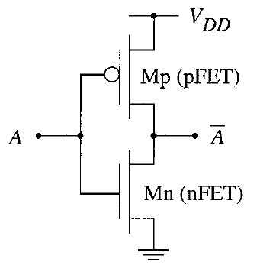
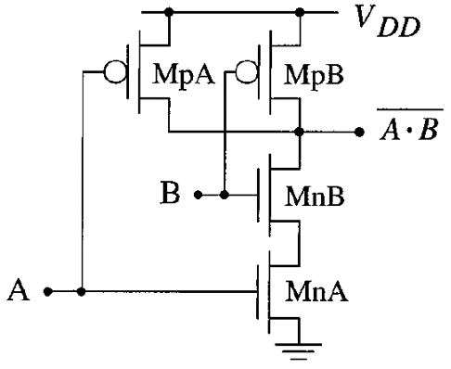
Number Representation
0
Vdd
Sized number
<size>`<base format><number>
4`b1001
16`habcd
Unsized number: 32bit
`<base format><number>
2009
`habc
x or z
x: an unknown value
z: a high impedance
X
0
Vdd
Conflicting drivers
Z (or floating)
0
Vdd
Tri-state buffer
Notes:
One important point in Verilog number representation is that we have new types of value, x (unknown) and z (high impedance).
Both represent unknown value.
However, they have different origins of unknown value.
X occurs when there are more than one drivers on a wire.
On the upper right of the slide, we have a circuit consisting of two inverters.
Note that the two outputs of the inverters are connected.
The inputs are Vdd (upper) and 0 (lower).
Thus the outputs of the inverters are 0 (upper) and Vdd (lower).
However, the outputs are connected to each other.
Thus, the connected wire cannot have either 0 nor Vdd.
In such a case, we consider the value unknown, i.e,. X.
Z occurs when there is no driver on a wire.
See the circuit, called a tri-state buffer, in the middle below.
Vdd to input A turns off PMOS transistor (i.e., switch) MpB and turns on NMOS transistor (switch) MnA.
0 to input B turns off NMOS transistor (i.e., switch) MnB.
Thus, there is no path from Vdd or ground to the output of this circuit.
In such a case, we do not know the voltage of the output, and consider the output in a floating or high-impedance state.
Note that impedance (in a simple case, resistance) between a wire and Vdd or Ground is very large when the wire is disconnected from Vdd or Ground.

Slide 18
Number Representation
Verilog’s nets and registers hold four-valued data
0
Obvious, logic 0, false condition
1
Obvious, logic 1, true condition
Z
Output of an undriven tri-state driver
Models case where nothing is setting a wire’s value
X
Models when the simulator can’t decide the value
Initial state of registers
When a wire is being driven to 0 and 1 simultaneously
Output of a gate with Z inputs
Notes:
We use four-valued data, 0, 1, Z and X.
We already covered the origins of Z and X.

Slide 19
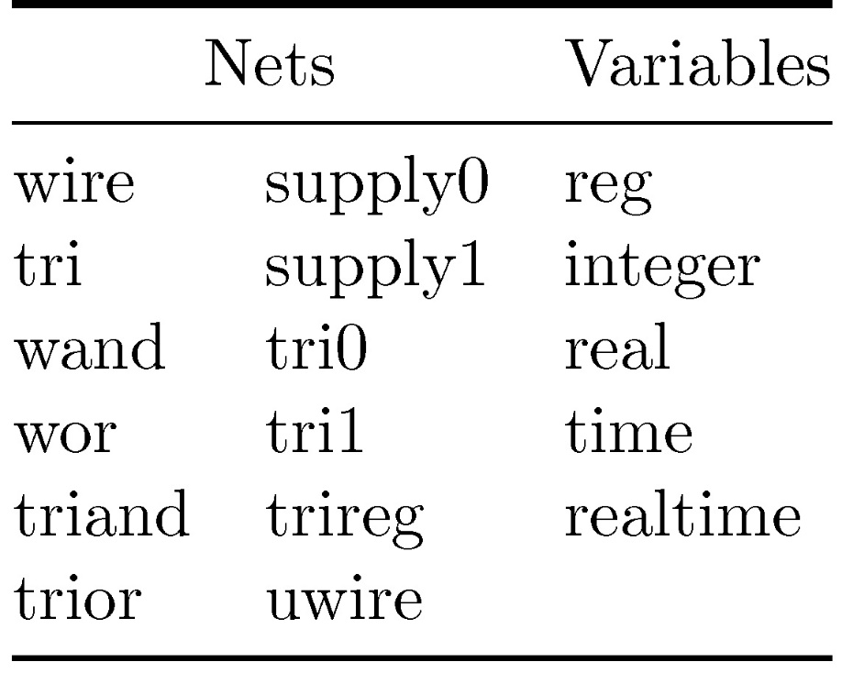
Data Types
Nets: any hardware connection points
Variables: any data storage elements
Notes:
In Verilog, wire and reg are very confusing concepts.
Both represent numbers.
However, their physical meaning is different.

Slide 20
Two Main Data Types
Nets(wire) represent connections between things
Do not hold their value
Take their value from a driver such as a gate or other module
Cannot be assigned in an initial or always block
Regs(reg) represent data storage
Behave exactly like memory in a computer
Hold their value until explicitly assigned in an initial or always block
Never connected to something
Can be used to model latches, flip-flops, etc.
Shared variables with all their attendant problems
A variable of type register does not necessary represent a physical register
Notes:
Wire is, as the name ‘wire’ shows, the value on a wire.
Thus, it cannot store its value.
Reg usually represents the register, i.e., a (set of) storage element(s), i.e., flip-flop(s).
A storage element keeps its value until a new value is written to it.
In summary, reg is a storage while wire is just a connecting wire between two hardware components.

Slide 21
The integer and time Variables
Integer variable
Contains integer values
Has at least 32 bits
Is treated as a signed reg variable
integer i, j;
integer data[7:0];
Time variable
Used for storing and manipulating simulation time
Used in conjunction with the $time system task
Only unsigned value and at least 64 bits
time events;
time current_time;
Notes:
In Verilog code, we can use typical decimal numbers and arrays.
Verilog has a special variable to represent time.
It is mostly used in testbench or just for simulation purpose.
You will see examples of time variable soon in the testbench examples.

Slide 22
Data Declaration
Size of register or wire
reg [0:7] A, B; // A and B are 8-bit wide with MSB as 0th bit
wire [3:0] Dout; // Dout is a 4-bit wire
reg [7:0] C; // C is 8-bit register with MSB as the 7th bit
[high:low] or [low:high]
The leftmost bit is the MSB
Assignments and concatenations
A = 8’b0101_1010;
B = {A[3:0] | A[7:4], 4’b0000};
B is set to the 1st 4-bit of A bitwise or-ed with the last 4-bit of A and then concatenated with 0000.
{} brackets means the bits of the 2 or more arguments separated by commas are concatenated together.
Notes:
When we declare variables, we need to specify their type, reg or wire.
Each reg or wire can have multiple bits.
Bit indexing is flexible, see [0:7] and [7:0] in this slide.
The first index represents the most significant bit.
Bits can be assembled, i.e., concatenated to form a longer bit-width.
See the array B in this slide.

Slide 23
Vectors
A vector ~ array
Especially useful to describe memory elements
wire a[3:0];
reg d[7:0];
wire [7:0] x[3:0];
reg [31:0] y[15:0];
integer states [3:0];
time current[5:0];
Notes:
A vector corresponds to an array in typical programming language.
It is especially useful to represent a memory element.
For instance,
reg [31:0] y[15:0];
represents a memory component y which can store 16 variables (each has 32 bits).

Slide 24
Memory
Memory
model ROM, RAM, or register files
reg [7:0] mema [7:0];
reg [7:0] memb [3:0][3:0];
wire sum [7:0][3:0];
mema[4][3]
mema[5][7:4]
memb[3][1][1:0]
sum[5][0]
Notes:
We can find more examples of variables for memory on this slide.
Please note that a memory component can represent any storage element like ROM (read only memory), RAM (random access memory), register files, etc.

Slide 25
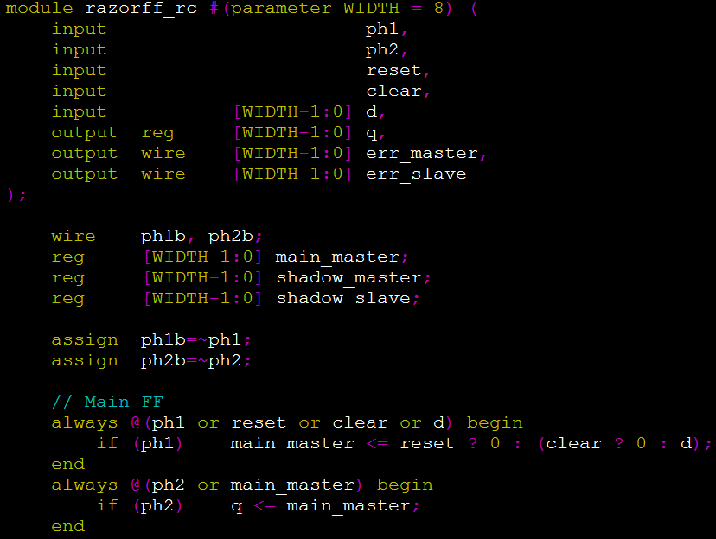
‘assign’
Lvalue, Rvalue
Lvalue: wire
Rvalue: wire, reg
Connecting wire physically
Notes:
In Verilog, the connection between the input (output) port of a module and a wire is made by ‘assign’ statement.
In this example, ph1b is a wire and ph1 is an input port of this module.
An assignment statement like
assign ph1b =~ph1;
connects the input port to the wire (by inserting an inverter between the two).
Note that the left-hand side of the assignment can have only the wire, not the register.

Slide 26
Basic Grammars
Describe a system by a set of modules
Equivalent to functions in ‘C’
Keywords
E.g., module, are reserved in all lower case letter
Operators (some examples)
Arithmetic: +, -, *, /, !, ~
Binary operators: &, |, ^, ~(bitwise), !(logical)
Shift: <<, >>
Relational: <, <=, >, >=, ==, !=
Logical: &&, ||
Identifiers
Equivalent to variable names
Identifiers can be up to 1024 characters
Comments
“//” for 1-line or /* to */ across several lines
Notes:
In Verilog, most of basic operators are the same as those in programming language C.
The key differences are the concept of module (similar to the class in C++), bitwise logical operations, etc.

Slide 27
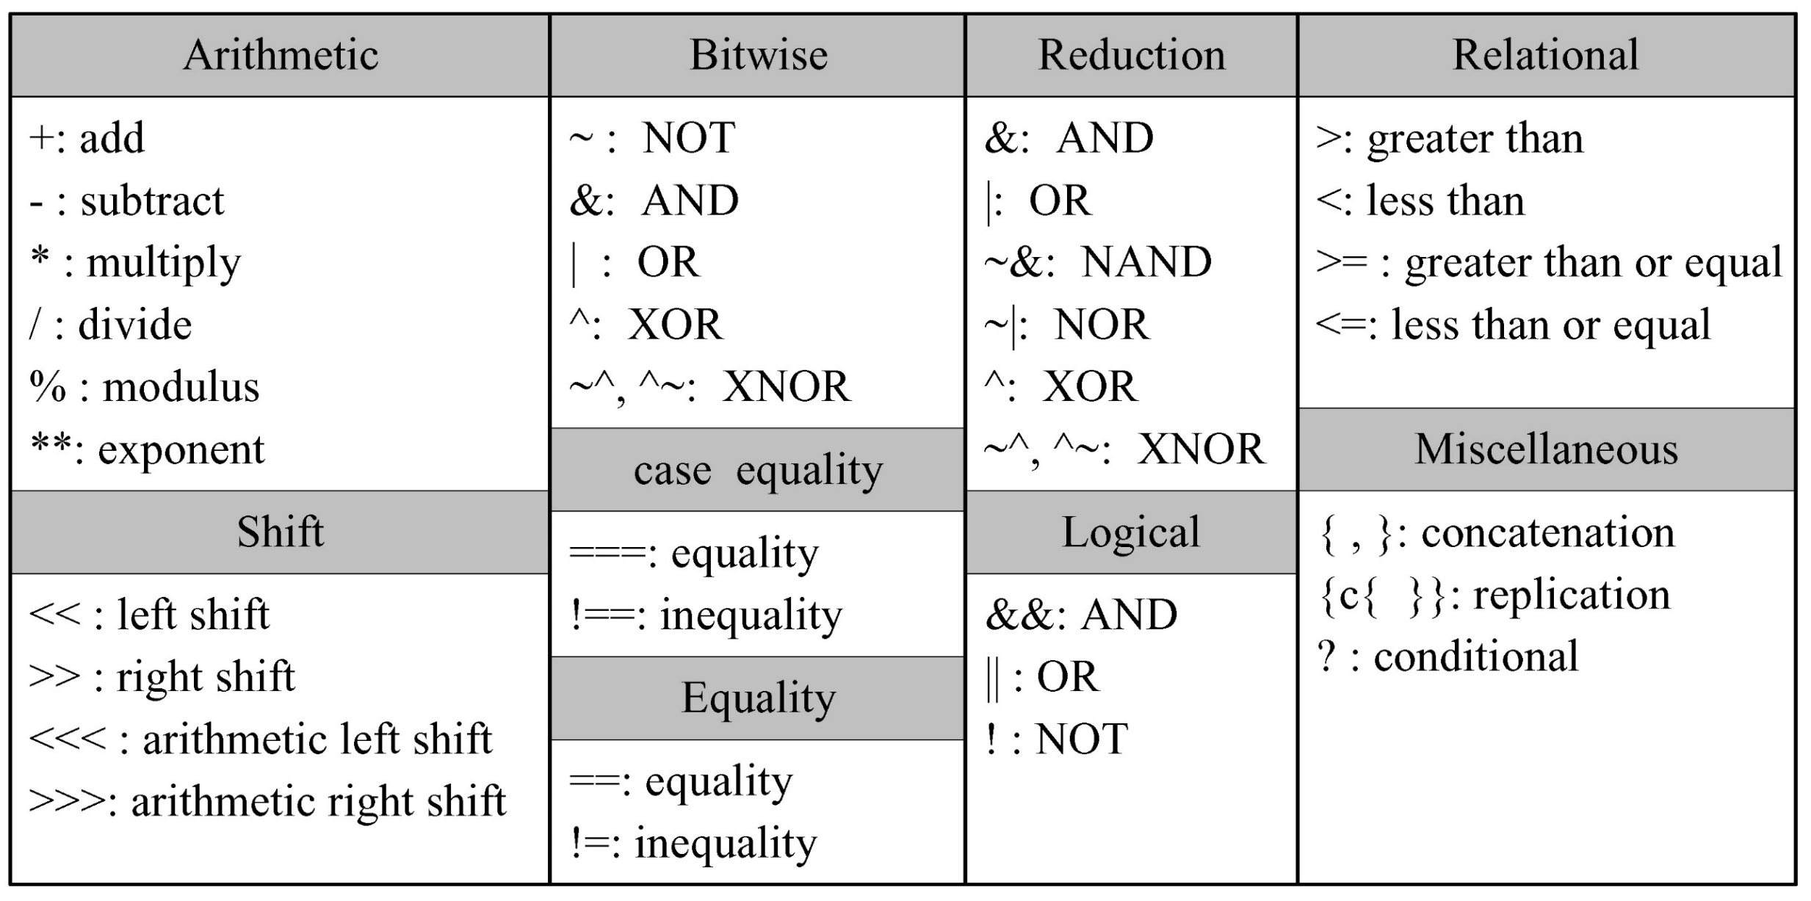
Operators
Notes:
This slides shows operators in Verilog.
Compared with those in C, there are new types of operators, bitwise, case equality, and reduction.
We will see code examples using them in the following slides.

Slide 28
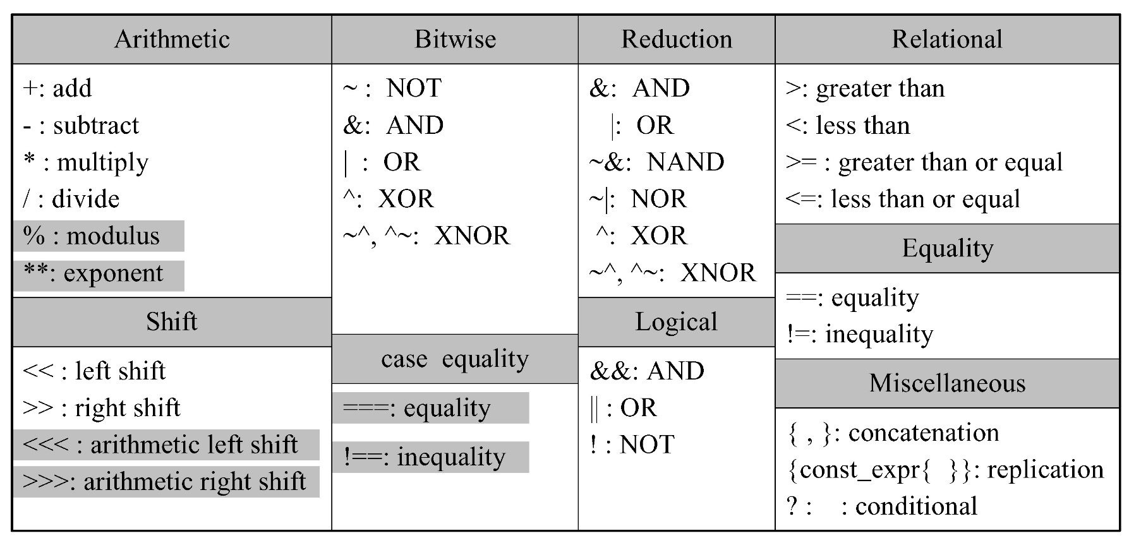
Synthesizable Operators
Notes:
We write Verilog code to realize a hardware implementation.
The hardware implementation is often based on very low level logical units like logic gates or some arithmetic units like adders.
Thus, some complex Verilog operators cannot be directed mapped to these physical components like gates or function units.
In such a case, our Verilog code cannot be implemented, also called as, synthesized in hardware.
This slide highlights some unsynthesizable operators in gray.
For instance, the modulus operator, % is not synthesized to a hardware component.
Thus, in case that we need modulus operation, we may need to use a divider to obtain the remainder or,
in most cases, use a shift operation in case that the divisor is a power of two.
Another unsynthesizable operator is case equality the examples of which we will see in the following slides.

Slide 29
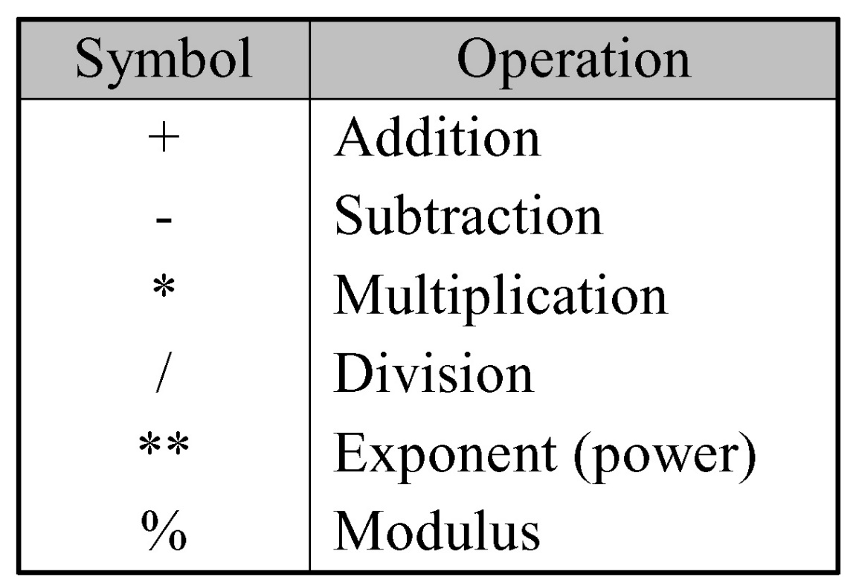
Arithmetic Operators
The result is x if any operand bit has a value x
Negative numbers except integer variable are represented as 2’s complement
-10/5 // -2
-`d10 / 5 // (2’s complement of 10) / 5 = (2³²-10) / 5

Slide 30
1s complement
If N is a positive number, then the negative of N (or its 1s complement) is N' = (2^{n} –1) – N
example: 1s complement of 7
shortcut: simply compute bit-wise complement ( 0111 -> 1000 )
4
2 = 10000
1 = 00001
2 –1 = 1111
7 = 0111
1000 = –7 in 1s complement form
4
To remedy the sign-magnitude encoding problem, 1s complement is introduced. Here, a negative of N (which is –N) is denoted by N’ and is expressed by (2^{n}-1)-N.
The 1st bit implicitly says the sign of the number. The merit of this encoding scheme is that subtraction becomes easier.
Notes:
Let’s try to review 1’s and 2’s complement.
As you can see in this slide, 1’s complement is the bit-wise complement (inversion) of the original value.

Slide 31
2s complement (cont’d)
If N is a positive number, then the negative of N (or its 2s complement) is N* = 2^{n} – N
example: 2s complement of 7
example: 2s complement of –7
shortcut: 2s complement = bit-wise complement + 1
0111 -> 1000 + 1 -> 1001 (representation of -7)
1001 -> 0110 + 1 -> 0111 (representation of 7)
4
2 = 10000
7 = 0111
1001 = repr. of –7
subtract
4
2 = 10000
–7 = 1001
0111 = repr. of 7
subtract
Likewise, the 2s compliment of a positive number N is denoted by N*. If you want to make a 2s complement in case of 4 wires, just subtract the number from 2**4. Another simple way to calculate 2s complements is to invert all the bits and add 1.
Notes:
We obtain the 2’s complement of a number by adding ‘1’ to its 1’s complement.

Slide 32
2s complement addition and subtraction
Simple addition and subtraction
simple scheme makes 2s complement the virtually unanimous choice for integer number systems in computers
4
+ 3
7
0100
0011
0111
– 4
+ (– 3)
– 7
1100
1101
11001
4
– 3
1
0100
1101
10001
– 4
+ 3
– 1
1100
0011
1111
Let’s see how we can add or subtract the numbers encoded by 2s complement. Now subtraction is not so different from addition. Just make 2s complement and add it.
Notes:
By using 2’s complement, we can perform subtraction by addition, i.e., by adding two numbers, one positive number and the other negative number.

Slide 33
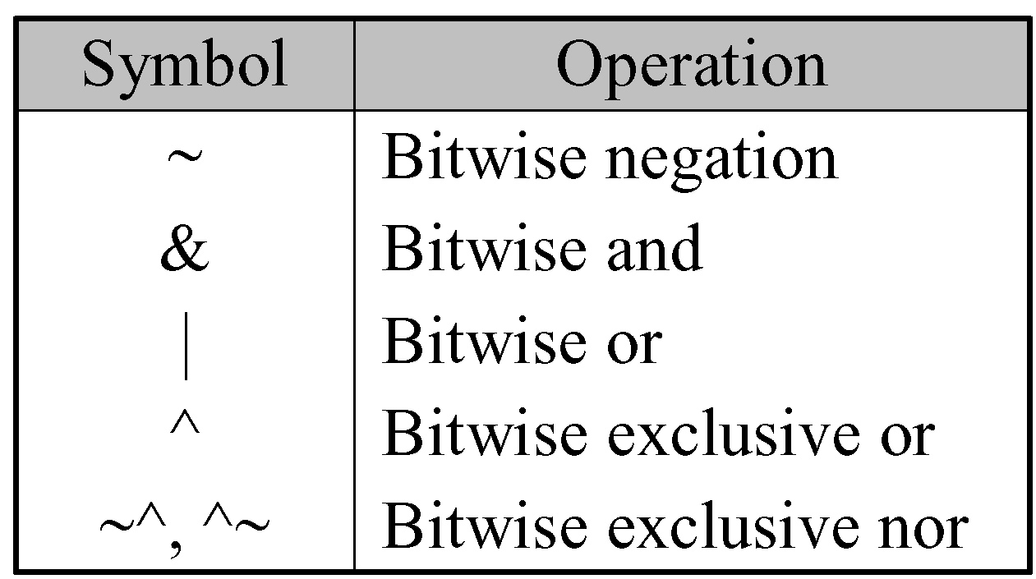
Bitwise Operators
A bit-by-bit operation
A z is treated as x
The shorter operand is zero-extended
Notes:
One salient difference of Verilog coding is bitwise operators.
We need to pay attention to the case that one of the input bits is Z.
We treat Z lie unknown X in logical operations.
Note that the output of bitwise operator has the same bit-width of the input
Since the logical operation is applied to each bit pair of the two inputs.

Slide 34
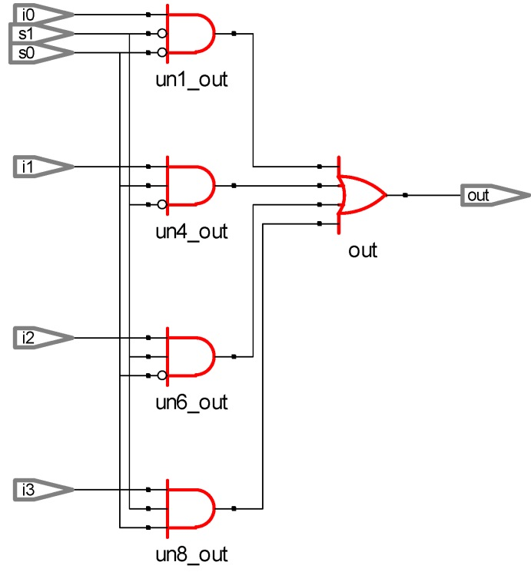
An Example: A 4-to-1 MUX
// using basic and, or , not logic operators
assign out = (~s1 & ~s0 & i0) |
(~s1 & s0 & i1) |
(s1 & ~s0 & i2) |
(s1 & s0 & i3) ;
Notes:
Let’s see a simple circuit of 4-to-1 MUX where the output is connected to one of the four inputs depending on two control signals s0 and s1.
As shown on the right, wire ‘out’ can be obtained by ORing four outputs each of which is the output of AND operation.
On the left, we can see the resulting circuits having 4 3-input AND ages and 1 4-input OR gate.

Slide 35
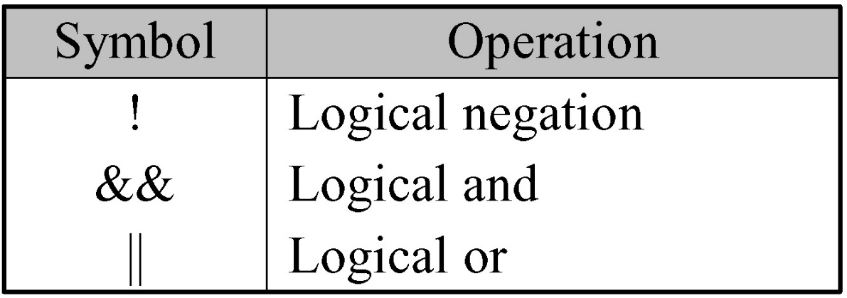
Logical Operators
Always evaluate to a 1-bit value, 0, 1, or x
The result is x (a false condition) if any operand bit is x or z
// X = 4'b1010,
Y = 4'b1000
X | Y // 4’b1010
X || Y // 1
X & Y // 4’b1000
X && Y // 1
Notes:
The logical operators consider an input (with single or multiple bits) as zero (logical 0) or non-zero (logical 1).
The result of logical operation is ‘0’ or ‘1’.
Thus, in this slide, for instance, X & Y gives 4bit output while X && Y gives 1bit output.

Slide 36
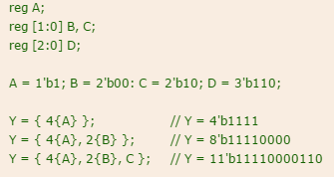
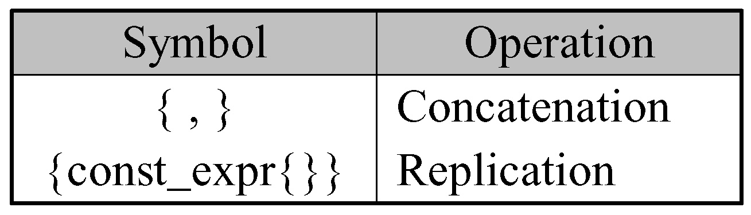
Concatenation/Replication Operators
Concatenation operator
y = {a, b[0], c[1]};
only for sized operand
Replication operator
y = {a, {4{b[0]}}, c[1]}; // y = {a, b[0], b[0], b[0], b[0], c[1]};
Notes:
Concatenation is to merge multiple binary values to form a binary value with a larger bit-width.
Replication is quite intuitive.
Both are often used in Verilog code.

Slide 37
An Example: A 4-Bit Full Adder
reg [3:0] x, y, sum;
reg c_in;
wire [3:0] sum;
wire c_out;
// specify the function of a 4-bit adder
assign {c_out, sum} = x + y + c_in;
Notes:
Let’s see an example of 4-bit full adder
Note that both inputs x and y are 4-bit numbers.
The addition of x, y and c_in is assigned to two parts.
The most significant bit goes to c_out while
The other bits go to sum.

Slide 38
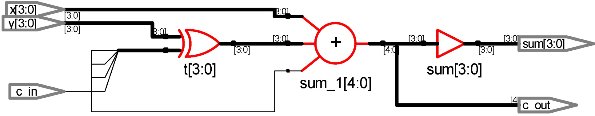
An Example: A 4-Bit Two’s Complement Adder
// specify the function of a two's complement adder
assign t = y ^ {4{c_in}};
assign {c_out, sum} = x + t + c_in;
Notes:
This example is a slight modification of the previous 4-bit adder to enable both addition and subtraction.
The difference is that we introduce new input t which becomes y if c_in is ‘0’ and y’s 1’s complement if c_in is ‘1’.
Thus, if c_in is ‘1’, t + c_in becomes y’s 2’s complement, which enables us to perform subtraction.

Slide 39
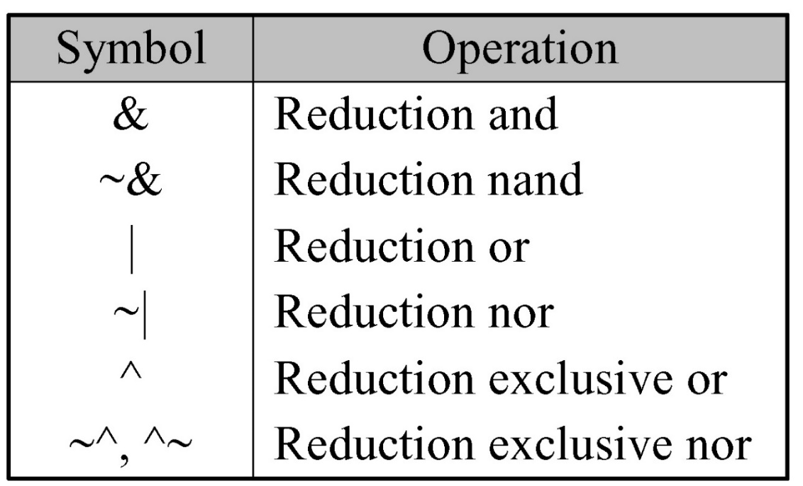
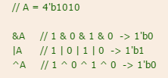
Reduction Operators
Perform only on one vector operand
Carry out a bit-wise operation
Yield a 1-bit result
Work bit by bit from right to left
Notes:
Reduction operator gives a 1-bit output.
It performs binary operations, e.g., and across all the input bits.

Slide 40
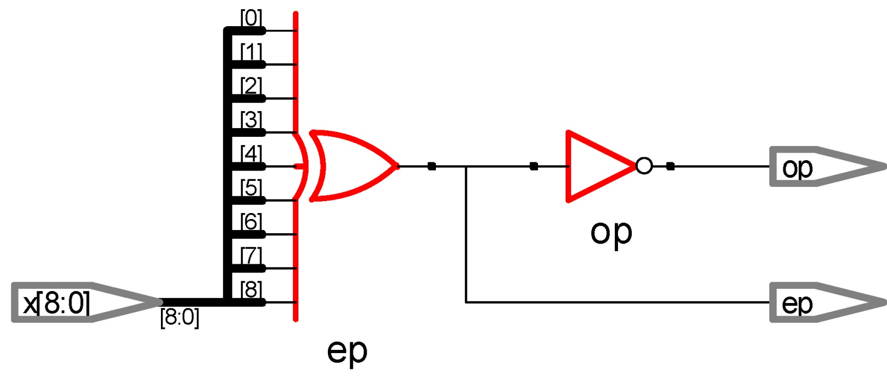
An Example: A 9-Bit Parity Generator
// dataflow modeling using reduction operator
assign ep = ^x; // even parity generator
assign op = ~ep; // odd parity generator
Notes:
Reduction operators are useful when we calculate the parity of binary value.
For instance, as shown at the bottom, ^x gives the result of XOR operation on all the bit values of input x.
As shown in the slide, it is implemented by instantiating an XOR gate with all the inputs of x as the input.

Slide 41
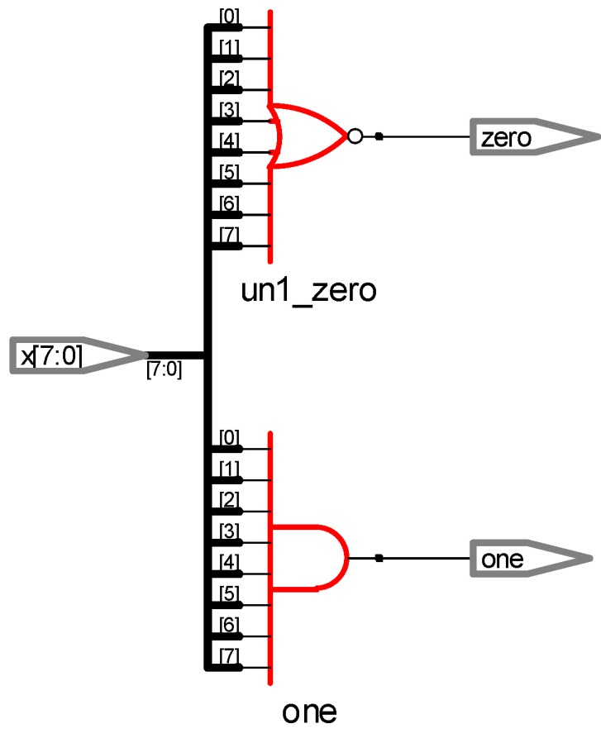
An Example: An All-Bit-Zero/One Detector
// dataflow modeling
assign zero = ~(|x); // all-bit zero
assign one = &x; // all-bit one
Notes:
Reduction operator is also useful when detecting all zero or all one pattern as the examples in this slide show.

Slide 42
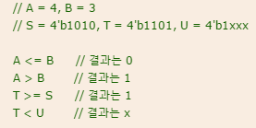
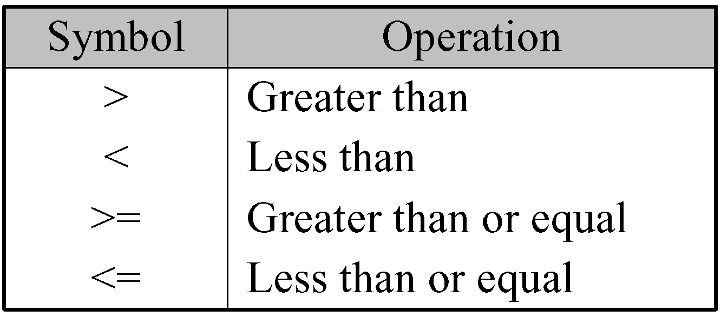
Relational Operators
The result is 1 if the expression is true and 0 if the expression is false
Return x if any operand bit is x or z
Notes:
Relational operators are the same as those used in typical programming language except one case where we have x as an input bit.
If there is at least one x in the input bits, the result of relational operator becomes x.

Slide 43
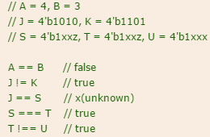
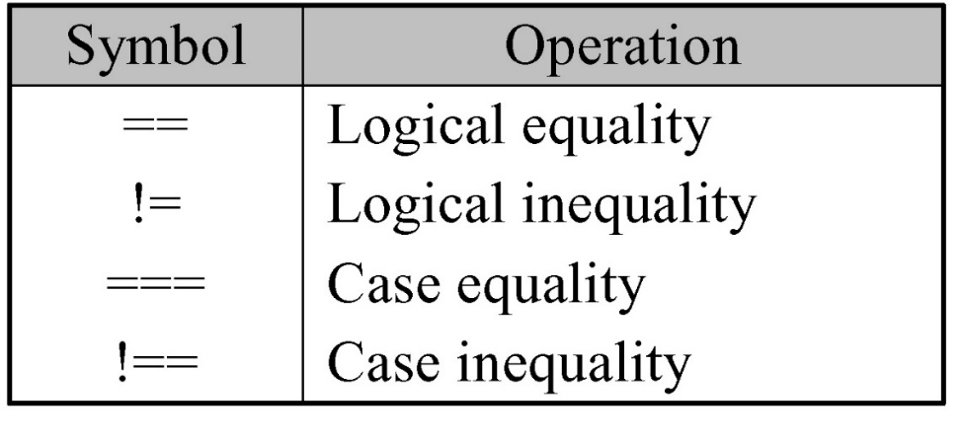
Equality Operators
Compare the two operands bit by bit
The shorter operand is zero-extended
Return 1 if the expression is true / 0 if the expression is false
The operators (==, !=)
yield an x if any operand bit is x or z
The operators (===, !==)
yield 1 if the two operands exactly match (‘x’ is also compared)
0 if the two operands not exactly match
Notes:
Equality operators are unique in Verilog.
They compare each bit pair of two inputs.
Note that, in case of logical (in)equality, if there is x in one of input bits, the result is x.
However, in case of case equality, we treat x as a valid input value.
Thus, even though there is x in one of the input bits, the bitwise comparison is performed to give an output bit for each bit position.

Slide 44
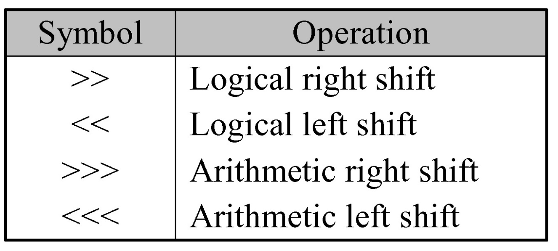
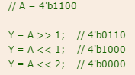
Shift Operators
Logical shift operators
0 is added in empty space
Arithmetic shift operators
0(<<<) or MSB(>>>) is added in empty space
Notes:
Shift operations shift the bit positions by one in the desired direction.
In case of arithmetic shift, we add the most significant bit (zero) to the empty bit positions(s).

Slide 45
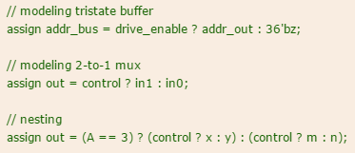
Conditional Operator
Usage: condition_expr ? true_expr: false_expr;
If condition_expr = x or z: the result = true_expr & false_expr (0 and 0 gets 0, 1 and 1 gets 1, others gets x )
Nesting is allowed
True_expr or Flase_expr can have condition
For example
assign out = selection ? in_1: in_0;
Notes:
Conditional operator is the same as the one in C language.

Slide 46
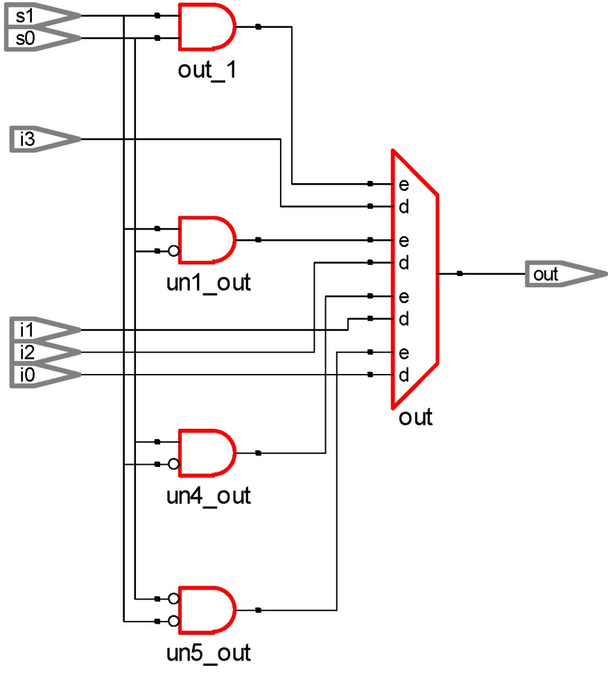
An Example: A 4-to-1 MUX
// using basic and, or , not logic operators
assign out = (~s1 & ~s0 & i0) |
(~s1 & s0 & i1) |
(s1 & ~s0 & i2) |
(s1 & s0 & i3) ;
// using conditional operator (?:)
assign out = s1 ? ( s0 ? i3 : i2) : (s0 ? i1 : i0) ;
Notes:
This slide shows two examples of 4-to-1 MUX
The left one uses conditional operators while the right one uses simple logical operations like AND and OR.

Slide 47
Operator Precedence
Operators | Operator Symbol | Precedence
Unary Multiply, Divide, Modulus | + - ! ~ * / % | Highest
Add, Subtract Shift | + - << >>
Relational Equality | < <= > >= == != === !==
Reduction Logical | &, ~& ^, ~^ |, ~| && | |
Conditional | ? : | Lowest
Notes:
This table shows the precedence relationship between operators.
Almost all the operators have the same precedence rule as C language.
In Verilog, we have new operators like reduction as shown in the table.

Slide 48
An initial Block
Execute exactly once during simulation
Start at simulation time 0 &
Operate independently (Parallel)
reg x, y, z;
initial begin // complex statement
x = 1`b0; y = 1`b1; z = 1`b0;
#10 x = 1`b1; y = 1`b1; z = 1`b1;
end
initial x = 1`b0; // single statement but not recommended
Notes:
In Verilog simulation, we run multiple blocks in parallel.
Among them, an initial block is executed only once in the beginning of the simulation.
In this slide, we can find two initial blocks.
Both runs in parallel starting from time 0.

Slide 49
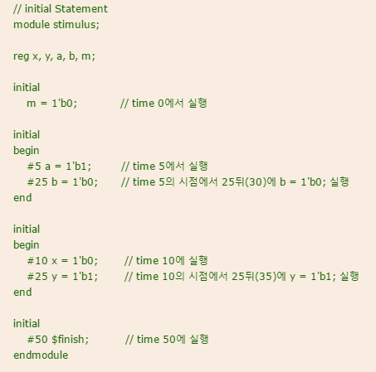
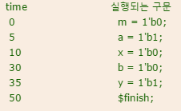
An initial Block
Notes:
This slide shows another example of multiple initial block runs.
We can find four initial blocks which run in parallel from time 0.
Note that the time flows independently at each initial block.
Thus, as we can see on the right, the signals change their values.
”# number” represents that the time advances by ‘number’ time units.
For instance, in the second initial block, in the first statement, we first advance time by 5 time units.
Then, a = 1’b1; is executed in the 2nd initial block.
Then, we advance time by 25 time units.
At time 30 (=5 + 25), this initial block executes another statement, b = 1’b0;
Note also that the last initial block is used to stop the simulation.
It executes $finish (which finishes simulation) at time 50.

Slide 50
An always Block
Starts at simulation time 0
Executes continuously during simulation
Behavior modeling should be located inside of procedural constructs
reg clock;
initial clock = 1`b0; //clock initialization
//with initial
always #5 clock = ~clock; // cycle = 10, 100MHz
initial # 1000 $finish; // $finish with initial
Notes:
Most of blocks are always blocks in Verilog.
It also starts at time 0.
Compared with the initial block, the always block executes continuously, as the name shows, “always”.
The function we want to realize in Verilog code is located inside of the always block.
In this slide, we see one always block which generates clock signal with the period of 10 time units
Because it inverts the clock signal every 5 time units (as denoted by #5).
As in the previous example, this also uses an initial block to finish the simulation at time 1000.

Slide 51
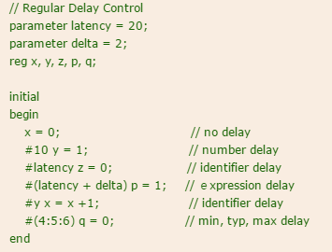
Regular Delay Control
Regular delay control
Defers the execution of the entire statement
For test bench
reg x, y;
integer count;
#25 y = ~x; // at time 25
#15 count = count + 1; // at time 40
Notes:
Compared with the other programming languages, one key difference of Verilog is time control.
You can specify timing behavior in your code.
For instance, on the left, you can see two sentences having time control with “# number”.
The first sentence, #25 y = ~x; represents that
We first advance time by 25 time units and then execute y = ~x.
You can see other time control examples on the right.
You can even use variables or multiple time delays to specify timing behavior of your design.

Slide 52
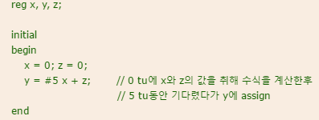
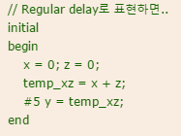
Intra-Assignment Delay Control
Intra-assignment delay control
Defers the assignment to the left-hand-side variable
Right side is already calculated
y = #25 ~x; // assign to y at time 25
count = #15 count + 1; // assign to count at time 40
y <= #25 ~x; // assign to y at time 25
count <= #15 count + 1; // assign to count at time 15
Notes:
There are two locations where you can find “# number”.
Let’s see two examples below.
x = 1’b0;
# 25 y = ~x; // 1st line
y = #25 ~x; // 2nd line
In the first line, we first advance time by 25 and execute y = ~x.
However in the second line, we first execute ~x and advance time by 25 units while holding the result.
Then, at time 25, we execute y = the result of (~x at time 0)
“# number” inside of assignment, called Intra-assignment delay, is often used to model the delay of compute element like logic gates.

Slide 53
Procedural Assignments
Syntax
variable_lvalue = [timing_control] expression
variable_lvalue <= [timing_control] expression
[timing_control] variable_lvalue = expression
[timing_control] variable_lvalue <= expression
lvalue : reg, integer, real, time (not net!!)
Two types
blocking
non-blocking
Notes:
Inside of always block, we have procedural assignments as shown in this slide.
There are two types of procedural assignment, blocking (=) and non-blocking (<=).

Slide 54
Procedural Assignments
The bit widths
If expression is longer than lvalue → Keeping LSB
If expression is shorter than lvalue → Zero-extended in MSB
Notes:
A procedural assignment can have short lvalue (left value) compared with rvalue.
For instance,
a <= b
Where a has 4 bits, while b has 8 bits.
In this case, the lowest significant bits are assigned to lvalue.
In the opposite case that lvalue has more bits than rvalue,
We append zero values to the most significant bit positions.

Slide 55
Blocking Assignments
Are executed in the specified order
Use the “=“ operator
Similar with C code
// blocking assignments
initial begin
x = #5 1'b0; // at time 5
y = #3 1'b1; // at time 8
z = #6 1'b0; // at time 14
end
Notes:
Blocking assignment uses the symbol ’=’, which is similar to other programming languages.
A blocking statement can start to execute only after the previous blocking statement finishes its execution.
That’s why it is called blocking.
In the example on this slide, the initial block has 3 blocking statements.
The first statement, first, executes the right-hand side (which is a constant in this case).
Then the entire statement is executed after 5 time units.
Thus, at time 5, x = 1’b0 is executed.
In the second statement, we first execute the right-hand side, 1’b1 (a constant in this cae).
Then, y = 1’b1 is executed at time 8 (=5+3).
As this example shows, a blocking statement can run only after the previous one finishes its execution.

Slide 56
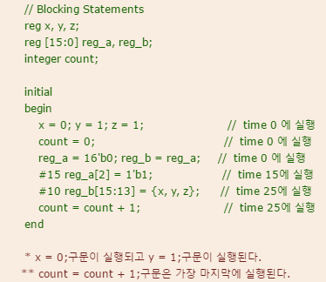
An Example: Blocking Assignments
Notes:
Let’s see a more complex example of block statement.
The key point here is where the time is controlled by “# number”.
We can find two such cases, #15 and #10.
Thus, all the blocking statements before #15 are sequentially executed.
However, the execution does not advance time.
In other words, the block statements before #15 are sequentially executed at time 0.
#15 advances the time by 15.
Then, at time 15, the statement reg_a[2] = 1’b1; is executed.
#10 advances the time by 10.
The statement reg_b[15:13] = {x,y,z} is executed.
Then, count = count + 1; is executed at the same time.

Slide 57
Non-Blocking Assignments
Use the “<=“ operator
Same with operator “<=“, distinguish by used position
Used to model several concurrent data transfers
reg x, y, z;
// nonblocking assignments
initial begin
x <= #5 1'b0; // at time 5
y <= #3 1'b1; // at time 3
z <= #6 1'b0; // at time 6
end
Notes:
Non-blocking assignments run independently from each other.
This slide shows three non-blocking statements.
Each of them runs in parallel.
Thus, x becomes 1’b0 at time 5, y 1’b1 at time 3, and z 1’b0 at time 6.

Slide 58
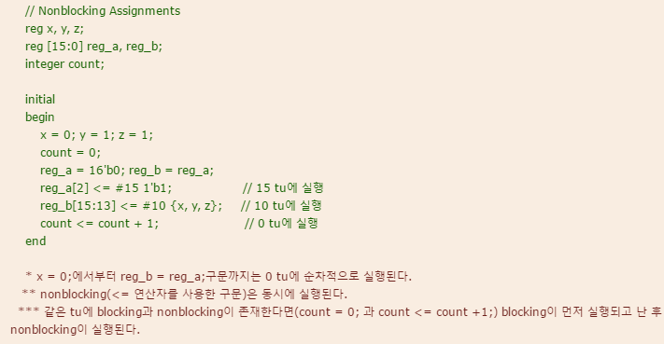
An Example: Non-Blocking Assignments
Notes:
Let’s see a complicated example where blocking and non-blocking statements are mixed.
At time 0, we execute the following statements in their order because they are blocking statements.
x = 0; y = 1; … reg_b = reg_a;
reg_a[2] <= 1’b1 is executed at time 15 while
reg_b[15:13] <= {x, y, z} is executed at time 10.
Note that count <= count + 1 is executed at time 0.

Slide 59
Event Timing Control
Edge-triggered event control
Level-sensitive event control
What is an event? → Value change of register and net
Notes:
Our hardware design is in most cases a sequential circuit based on clock.
We execute our hardware function at a clock event, e.g., rising edge of clock.
Event timing control is related with the detection of such an event to execute our function upon it.

Slide 60
Edge-Triggered Event Control
Edge-triggered event control
@(posedge clock)
@(negedge clock)
always @(posedge clock) begin
reg1 <= #25 in_1;
reg2 <= @(negedge clock) in_2 ^ in_3;
reg3 <= in_1;
end
Notes:
always @(posedge clock) begin
… // here we have our function
End
Is the most popular statement in Verilog.
It is usually used to represent a sequential circuit behavior.
“always @(posedge clock)” means we detect EVERY clock rising edge.
Upon a detection, we execute the statements in the block.
In the example here,
at clock rising edge, we execute 3 statements.

Slide 61
Event or Control
Event or control
or
,
* or (*) means any signals
always @(posedge clock or negedge reset_n)
if (!reset_n) q <= 1`b0;
else q <= d;
Notes:
In the always statement, like always @(sensitivity list)
We call those in the parentheses ”sensitivity list”.
Whenever the sensitivity list becomes true, the always block is executed.
In the example here, we have as the sensitivity list, posedge clock or negedge reset_n,
Which is the most popular sensitivity list which detects the clock rising edge or reset falling edge.
When the event occurs, we execute two statements.
The first one, if (!reset_n) q <= 1’b0; checks the reset value. If it is 0 (meaning reset operation), we set q to 1’b0, i.e., reset it.
If reset_n is not ‘0’, then we execute q <= d; which means we take the current input d and store it in the signal q, which actually makes a flip-flop.

Slide 62
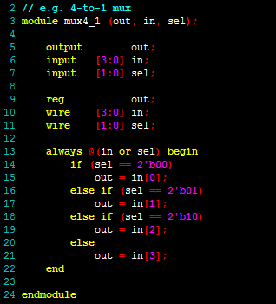
if … else Statement
Syntax
if (expr1)
true_stmt1;
else if (expr2)
true_stmt2;
..
else
default_stmt;
Notes:
This is the same as in other programming languages.

Slide 63
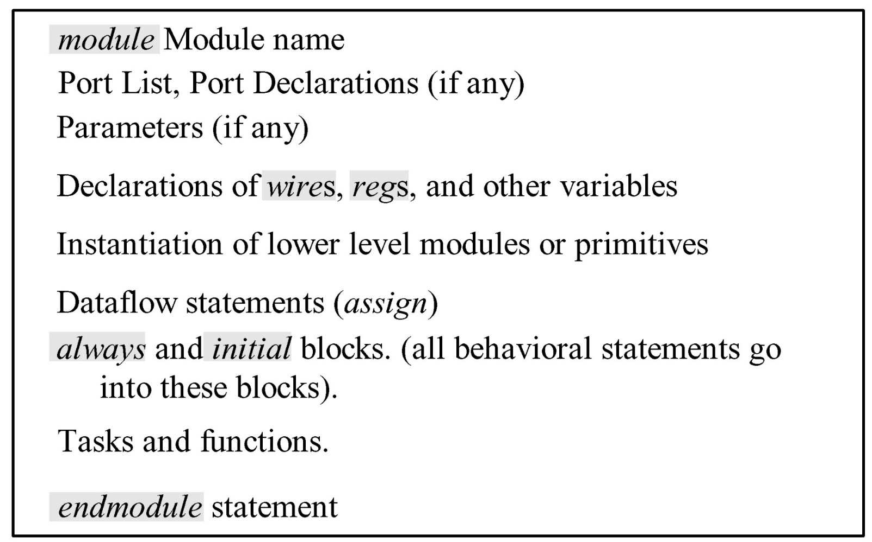
Modules in Verilog
Module --- The basic building block
Notes:
The Verilog code is composed on modules.
As this slide shows, the module consists of several elements.
We will see their examples in the following slides.

Slide 64
Port Declaration
Types of ports
input
output
inout
module adder(x, y, c_in, sum, c_out);
input [3:0] x, y;
input c_in;
output reg [3:0] sum;
output reg c_out;
…
Notes:
A module usually has input and output ports as this slide shows.
The adder module has five ports, x, y, c_in, sum, and c_out.
Each of the two inputs x and y has 4 bits.

Slide 65
Parameter Ports
module module_name
#(parameter SIZE = 7,
parameter WIDTH_BUSA = 24, WIDTH_BUSB = 8,
parameter signed [3:0] mux_selector = 4’b0
) //parameter ports
(port list or port list declarations)
...
endmodule
Notes:
A module can have parameters as this example shows.
This module has a parameter called SIZE and its default value is 7.
The default value can be overridden by a new value when the module is instantiated, i.e., really used as a hardware module.

Slide 66
Types of Parameters
Module parameters
parameter
Localparam
Specify parameters
parameter SIZE = 7;
parameter WIDTH_BUSA = 24, WIDTH_BUSB = 8;
parameter signed [3:0] mux_selector = 4’b0;
Notes:
There are two types of parameters, (normal) parameter and Localparam.
We have the examples of parameter here and will have examples of Localparam in the following slides.

Slide 67
Constants Specified Options
`define compiler directive
`define BUS_WIDTH 8
defined at outside of module (applied to entire code)
parameter
parameter BUS_WIDTH = 8;
cannot be defined outside of module
localparam
localparam BUS_WIDTH = 8;
cannot be defined outside of module
Notes:
In addition to parameters, we can also use ‘define.
As this slide shows, ‘define is used outside of module and, thus, is applied to the entire code (having multiple modules).
On the contrary, parameter is applied to only its associated module.

Slide 68
Parameterized Modules
module adder_nbit(x, y, c_in, sum, c_out);
parameter N = 4; // set default value
input [N-1:0] x, y;
input c_in;
output [N-1:0] sum;
output c_out;
assign {c_out, sum} = x + y + c_in;
endmodule
Notes:
This is an example parameterized module where we can set the number bits in inputs and output of the adder.
In other words, when we instantiate an adder, we can determine the bit-width though it can be different from the default value of 4.

Slide 69
Overriding Parameters
Using the defparam statement
When the module is defined
When the module is instantiated
module counter_nbits (clock, clear, qout);
parameter N = 4; // define counter size
always @(negedge clock or posedge clear)
begin // qout <= (qout + 1) % 2^n
if (clear) qout <= {N{1'b0}};
else qout <= (qout + 1) ;
End
// define top level module
…
output [3:0] qout4b;
output [7:0] qout8b;
// instantiate two counter modules
defparam cnt_4b.N = 4, cnt_8b.N = 8;
counter_nbits cnt_4b (clock, clear, qout4b);
counter_nbits cnt_8b (clock, clear, qout8b);
Notes:
This slide shows how we can adjust the parameter for instantiation.
On the left, we have a module definition for n-bit counter with the default size of 4.
On the right, we see two instantiations of the counter.
One counter has N of 4 while the other has 8.
In order to specify parameter values at the moment of instantiation, we use defparam as this example shows.
Note that cnt_4b and cnt_8b are the instance names and for each of different instances we can specify its own parameter as this example shows.

Slide 70
Overriding Parameters
Using module instance parameter value assignment -one parameter
When the module is defined
When the module is instantiated
module counter_nbits (clock, clear, qout);
parameter N = 4; // define counter size
…
always @(negedge clock or posedge clear)
begin // qout <= (qout + 1) % 2^n;
if (clear) qout <= {N{1'b0}};
else qout <= (qout + 1) ;
end
// define top level module
…
output [3:0] qout4b;
output [7:0] qout8b;
// instantiate two counter modules
counter_nbits #(4) cnt_4b (clock, clear, qout4b);
counter_nbits #(8) cnt_8b (clock, clear, qout8b);
Notes:
When we have only one parameter in the module definition,
We can simplify the instantiation as the right-hand side of this slide shows.
We just used #(4) and #(8) to specify new parameter values of 4 and 8, respectively.

Slide 71
Overriding Parameters
Using module instance parameter value assignment - two parameters
module hazard_static (x, y, z, f);
parameter delay1 = 2, delay2 = 5;
…
and #delay2 a1 (b, x, y);
not #delay1 n1 (a, x);
and #delay2 a2 (c, a, z);
or #delay2 o2 (f, b, c);
endmodule
hazard_static #(.delay2(4), .delay1(6)) example (x, y, z, f);
parameter value assignment by name --- minimize the chance of error!
// define top level module
module …
…
hazard_static #(4, 8) example (x, y, z, f);
Notes:
This slide shows a case that we have two parameters in the module and set their values in a simple form during instantiation.
Specifically, the module hazard_static has two parameters delay1 and delay2.
They are set to 4 and 8, respectively, when we instantiate an instance named example as shown at the bottom.

Slide 72
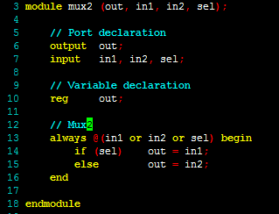
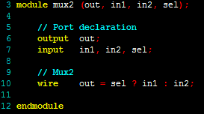
An Example: Module Definitions
Variable names
All undeclared variables are wires and are one bit wide.
Good Practice
: Declare all variables!!
Notes:
There are two types of port declaration as we can see in this slide.
On the left, we first give only the names of port, like module mux2 (out, in1, in2, sel);
Note that we do not know which port is input or output yet.
Then, we declare the polarity, i.e., input or output of each port like
output out;
input in1, in2, sel;
We can find another example on the right.

Slide 73
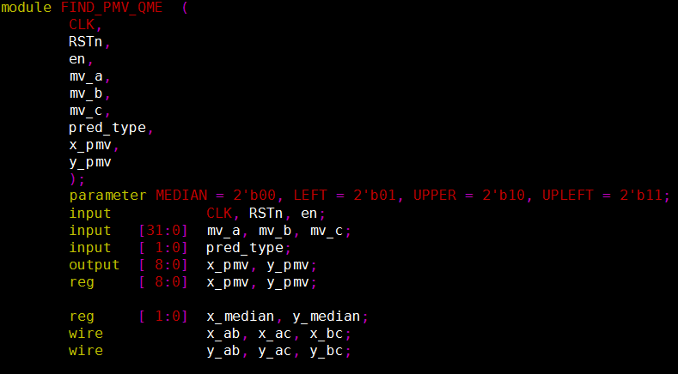
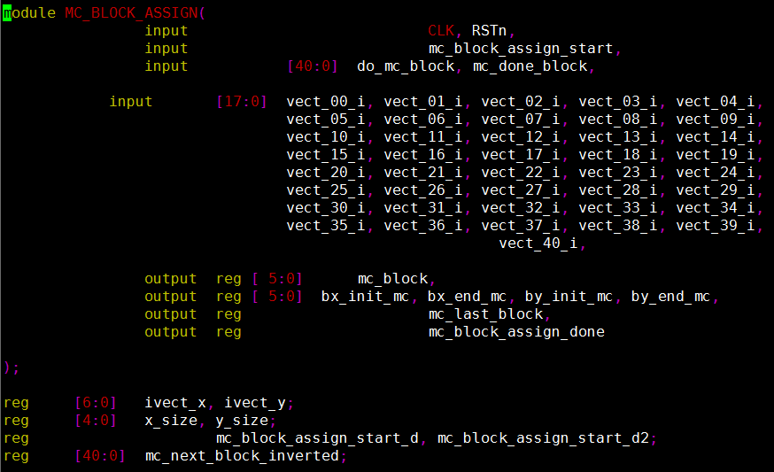
An Example: Module Definitions
Port list style
Port list declaration style
Notes:
In this slide we can see both types of port declaration.
The left one we already know is called port list style.
The right one, called port list declaration style, declares both port name and polarity in the first parentheses.

Slide 74
Module Definitions
// port list style
module module_name [#(parameter_declarations)][port_list];
parameter_declarations; // if no parameter ports are used
port_declarations;
other_declaration;
statements;
endmodule
// port list declaration style
module module_name [#(parameter_declarations)][port_declarations];
parameter_declarations; // if no parameter ports are used
other_declarations;
statements;
endmodule
Notes:
This slide shows all the details you can specify for a module declaration.

Slide 75
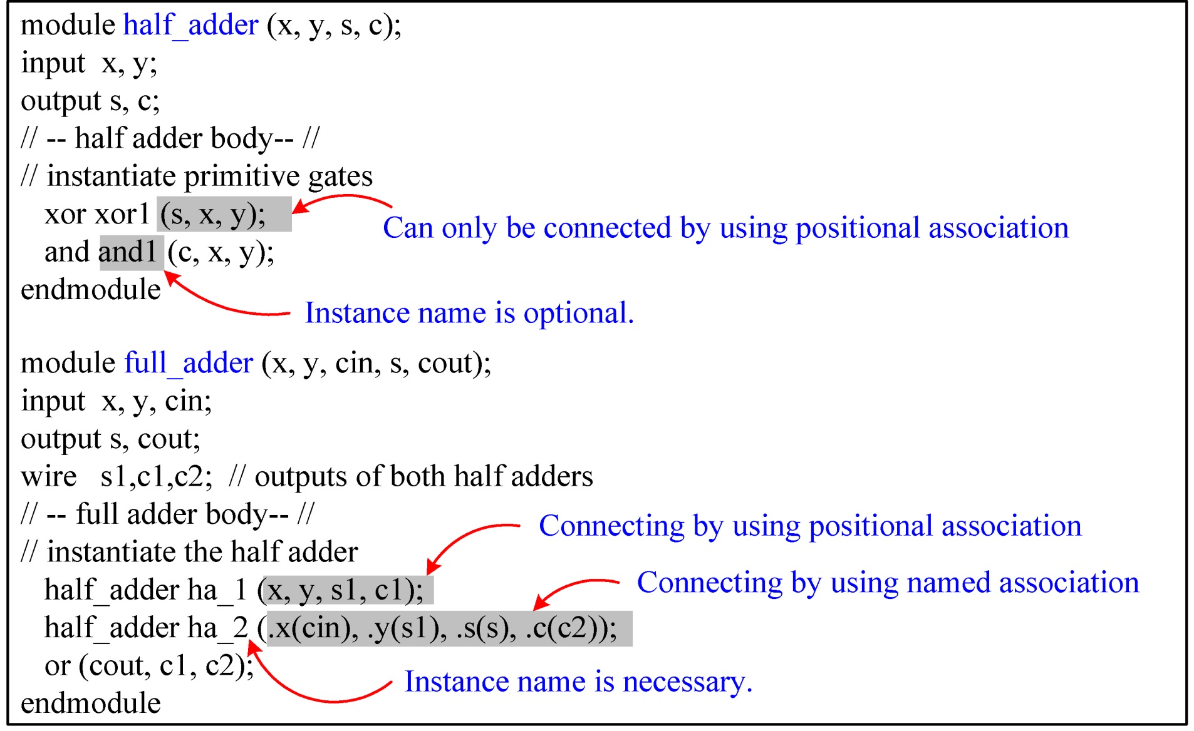
Module Instantiation and Port Connection
Notes:
This slide gives an example of module instance.
At the top of the slide, we have module declaration for half_adder.
At the bottom, we instantiate this module with two instances, ha_1 and ha_2.
The module instantiation shows two different types of port connection.
In the second one,
half_adder ha_2(.x(cin), .y(s1), .s(s), .c(c2));
we connect each port of the instance to the corresponding wire, e.g., input port x is connected to wire cin.
In the first one,
half_adder ha_1 (x,y,s1,c1);
we connect the wires x, y, s1, c1 to the four ports of half_adder in an implicit way.
In terms of readability and debugging. It will be better to take the first type of explicit port connection.

Slide 76
Module Instantiation
Syntax module_name [#(parameters)] instance_name ([ports]);
Port Connection Rules
Named association (.port_id1(port_expr1),..., .port_idn(port_exprn))
Positional association (port_expr1, ..., port_exprn)
Notes:
This slide differentiate the two types of port connection we saw in the previous slide,
Name association and positional association.
In the previous example,
half_adder ha_2(.x(cin), .y(s1), .s(s), .c(c2));
uses the named association
while
half_adder ha_1 (x,y,s1,c1);
uses the positional association.

Slide 77
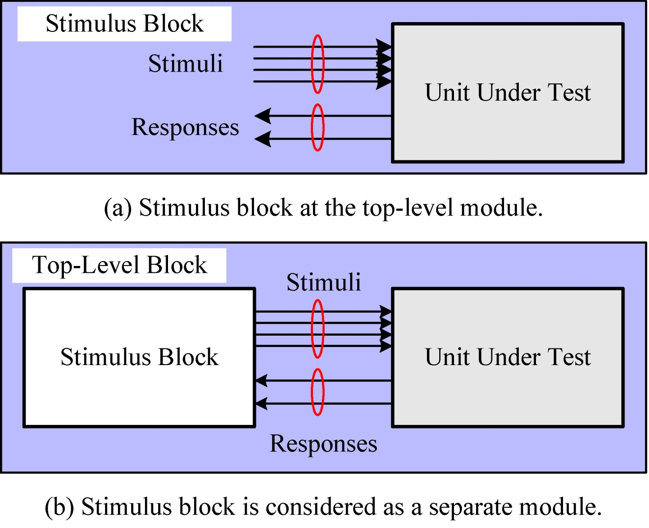
Simulation
Stimulus Block = Test Bench
Notes:
The final goal of Verilog design is to realize a hardware function on FPGA or a real silicon chip.
In order to validate the functionality of our Verilog design, we run simulation of hardware implementation since the hardware implementation takes long time and will increase the design time.
In order to simulate our Verilog design, as the bottom of the slide shows, we need a block which provides our design under test with input and receive the responses from our design.
We call such a block test bench.

Slide 78
An Example: A 4-bit Adder
// Gate-level description of 4-bit adder
module four_bit_adder (x, y, c_in, sum, c_out);
input [3:0] x, y;
input c_in;
output [3:0] sum;
output c_out;
wire C1,C2,C3; // Intermediate carries
// -- four_bit adder body--
// Instantiate the full adder
full_adder fa_1 (x[0],y[0],c_in,sum[0],C1);
full_adder fa_2 (x[1],y[1],C1,sum[1],C2);
full_adder fa_3 (x[2],y[2],C2,sum[2],C3);
full_adder fa_4 (x[3],y[3],C3,sum[3],c_out);
endmodule
Notes:
Let’s assume that we wrote a Verilog code like the one in this slide and want to validate its functionality by simulation.
This design is a 4-bit adder composed of four full adders as the code shows.
The module has 3 inputs, x, y, and c_in and 2 outputs sum and c_out.

Slide 79
An Example: A Test Bench of 4-bit Adder
`timescale 1ns / 100 ps // time unit is in ns.
module four_bit_adder_tb;
//Internal signals declarations:
reg [3:0] x;
reg [3:0] y;
reg c_in;
wire [3:0] sum;
wire c_out;
// Unit Under Test port map
four_bit_adder UUT (.x(x), .y(y), .c_in(c_in), .sum(sum), .c_out(c_out));
reg [7:0] i;
initial
for (i = 0; i <= 255; i = i + 1) begin
x[3:0] = i[7:4]; y[3:0] = i[3:0]; c_in =1'b0;
#20 ; end
Notes:
This is the test bench for the 4-bit adder.
In the middle of test bench, we can find an instantiation of our four_bit_adder.
The instance name is UUT.
For port connection, we use named association like .x(x).
At the bottom, we have a for loop where we set the values of inputs, i.e., x[3:0], y[3:0], and c_in.
In the words, the for loop generates stimulus input to our design (under test).
Each iteration of for loop takes 20 time units as “# 20” shows.
1 time unit represents 1 ns as the first sentence of the test bench shows.
This loop has 256 iterations each of which takes 20ns.
Thus, the simulation runs for 256*20 (= 5120) ns.
In order to validate the functionality, we need to check the output of UUT at each iteration with the correct ones.
To do that, we may need to write the outputs (together with inputs) in a file or on a screen in waveform.
Our design tool Vivado provides such functionalities and you will use them in your lab and practice.

Slide 80
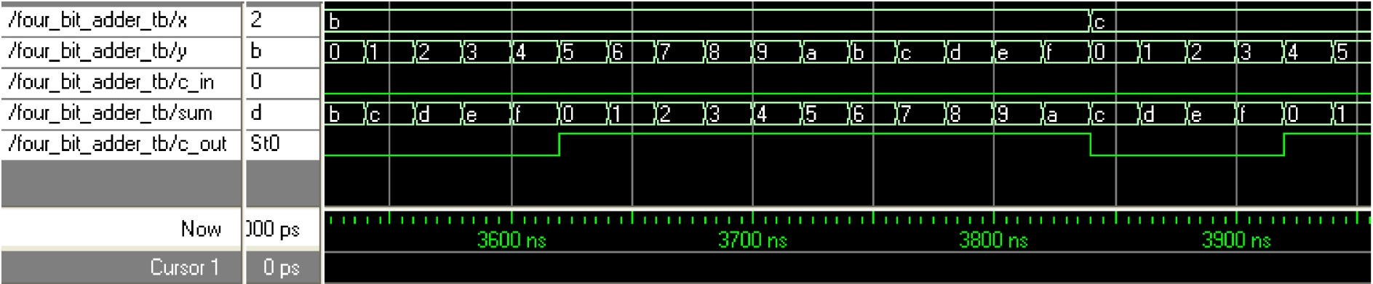
An Example: Simulation Result
Notes:
This is an example of simulation result shown in the waveform of Vivado tool.

Slide 81
Agenda
Lecture
Verilog design basics and testbench
Introduction to the lab of 2nd Week (by TAs)
Design a simple hardware function in Verilog on Vivado
Verilog basics
Simulation
Notes:
This is the end of Week 2 lecture.
Our TAs will continue the lecture class to introduce this week’s lab where
You will practice Verilog basics by designing a simple function, and learn how to run simulation using Vivado software tool.

